Slide 1

Infrastructure as Code on Azure
Victor Silva
Technology and Infrastructure Analyst
AT

Slide 3
Infrastructure as Code

Slide 4
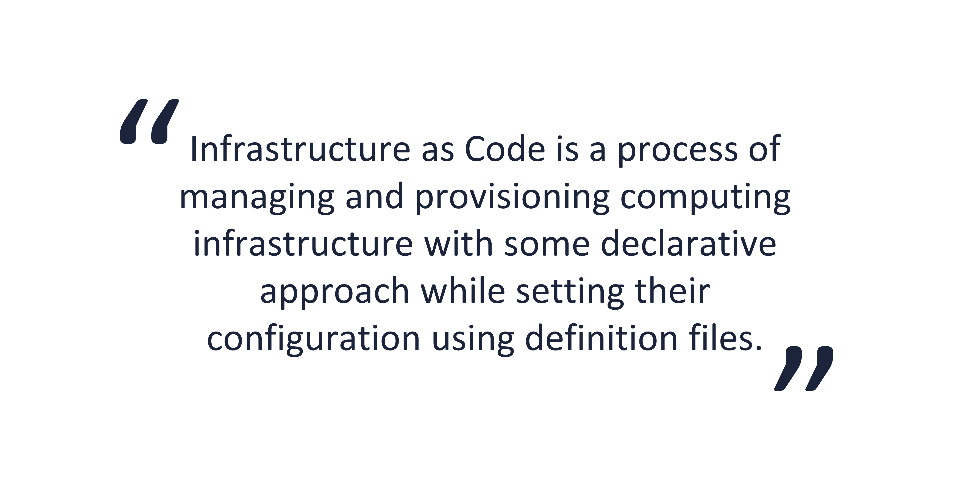

Slide 5
Consistency
Accelerating
Extensibility
Reusability

Slide 6
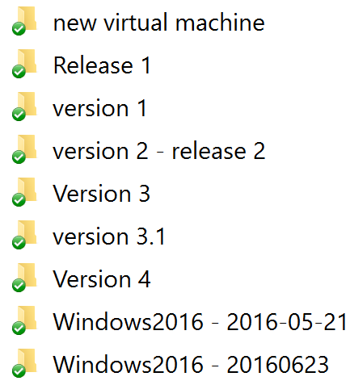

Slide 7


Slide 8

Treat your servers
like cattle,
not pets

Slide 9


Slide 10

https://thinkacloud.wordpress.com/2016/01/18/docker-for-the-enterprise-are-we-there-yet/

Slide 11






Slide 12
Ansible

Slide 13
> Agent-less communication.
> Easy learning curve.
> Playbook structure is simple and clearly structured.
> Procedural and Ordered.

Slide 14
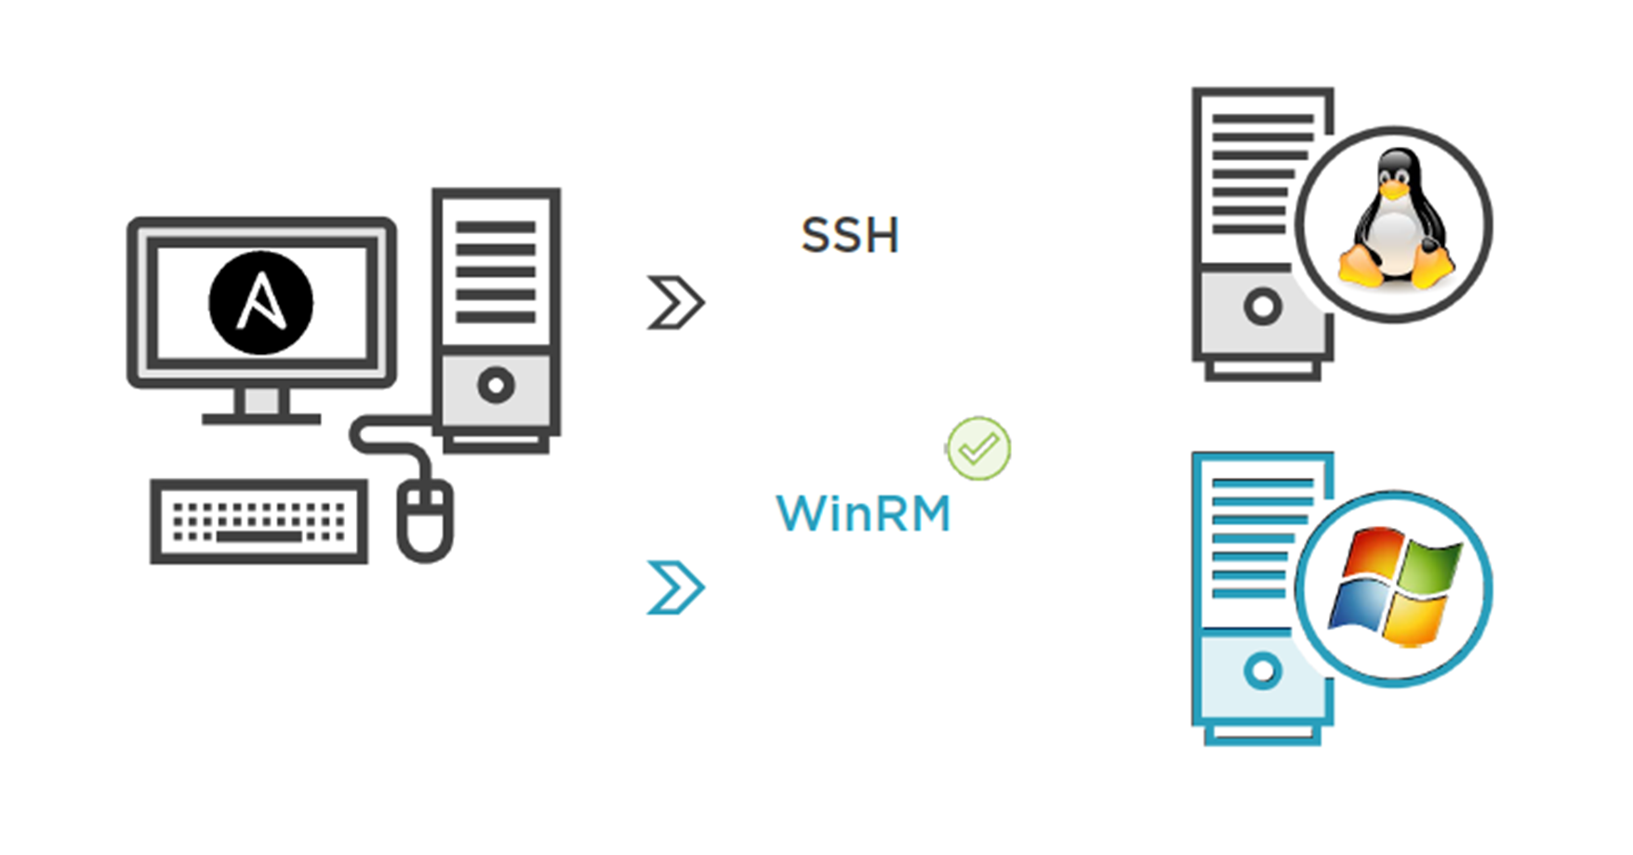


Slide 15
Runbook’s anatomy
---
- name: install apache
hosts: webservers
user: root
tasks:
name: install httpd
yum: name=httpd state=present
service: name=httpd state=running

Slide 16
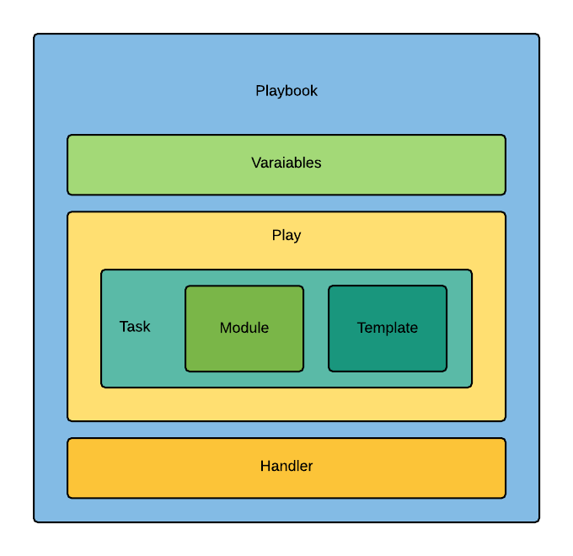

Slide 17

Azure Cloud Shell

Slide 18
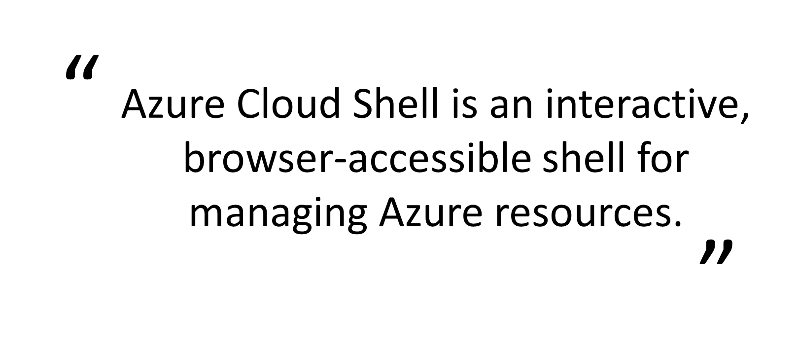

Slide 19

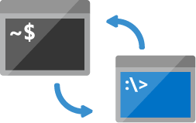


Shell access from virtually anywhere (https://shell.azure.com)
Choose your preferred shell experience (Bash and PowerShell)
Common tools and programming languages included
Persist your files in attached cloud storage

Slide 20
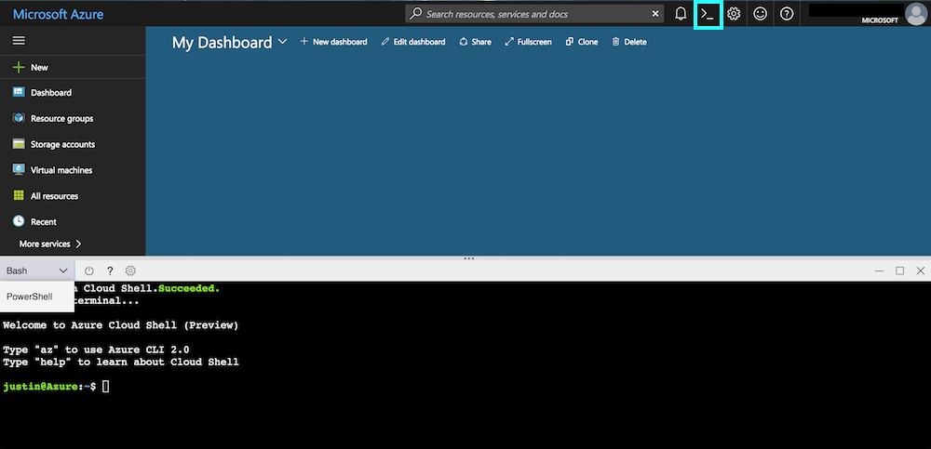

Slide 21


DEMO
> Create a Playbook.
> Manage Azure resources.
> Azure Cloud Shell tour.

Slide 22

If you think you will do a task twice – automate it!

Slide 23

ARM Templates

Slide 24
> ARM templates are a declarative way of describing your infrastructure.
> ARM templates are json files.
> Contain 4 sections: parameters, variables, resources and output

Slide 25
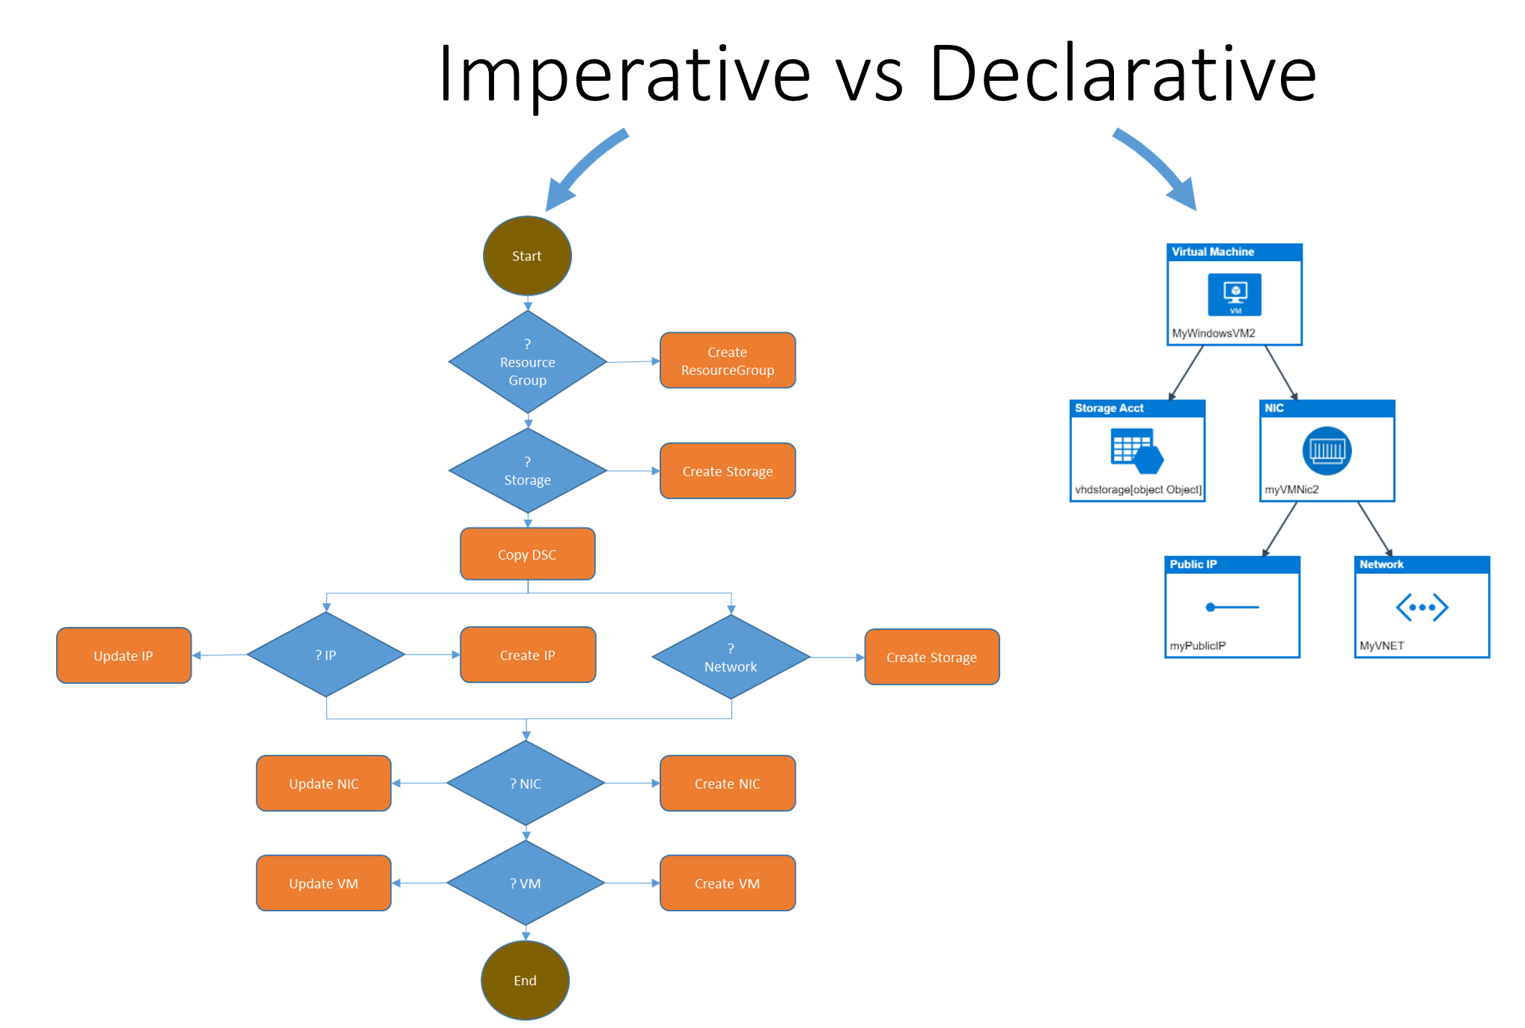

Slide 26
Azure Quickstart Templates:
https://azure.microsoft.com/en-us/resources/templates
Github repo:
https://github.com/Azure/azure-quickstart-templates

Slide 27
DEMO
> Generate a template.
> Deploy to Azure.

Slide 28

Azure Automation and
PowerShell DSC

Slide 29
> A way to automate the manual, long running, frequently repeated tasks.
> Automatically performed at regular intervals.
> Runbooks + PowerShell DSC.

Slide 30
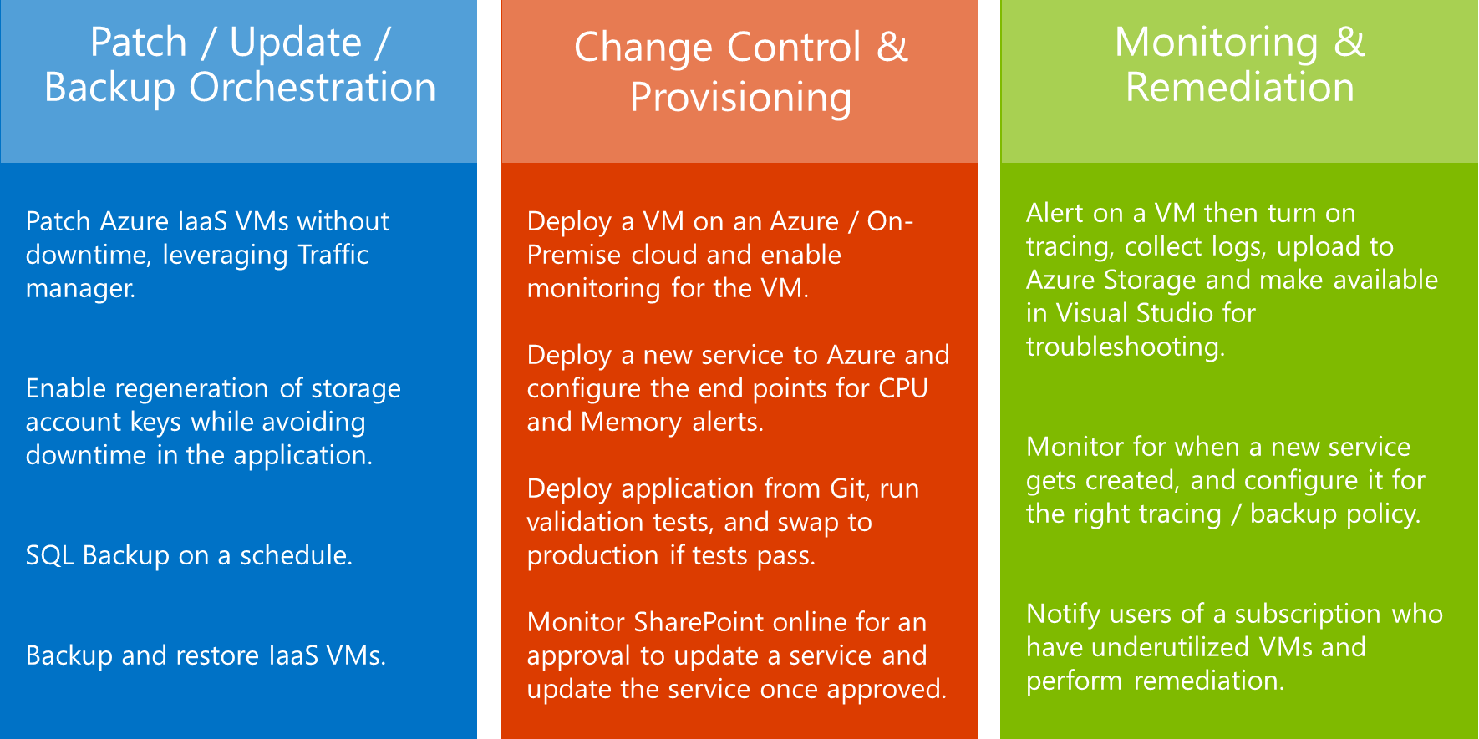

Slide 31
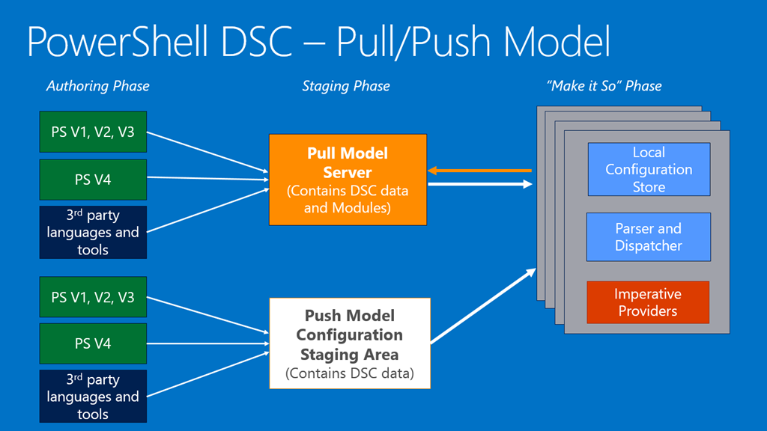

Slide 32
Extension
PowerShell syntax
Configuration scripts
Configuration
Create and deploy
Configuration files
Control
Apply the configuration
Local Configuration mechanism

Slide 33
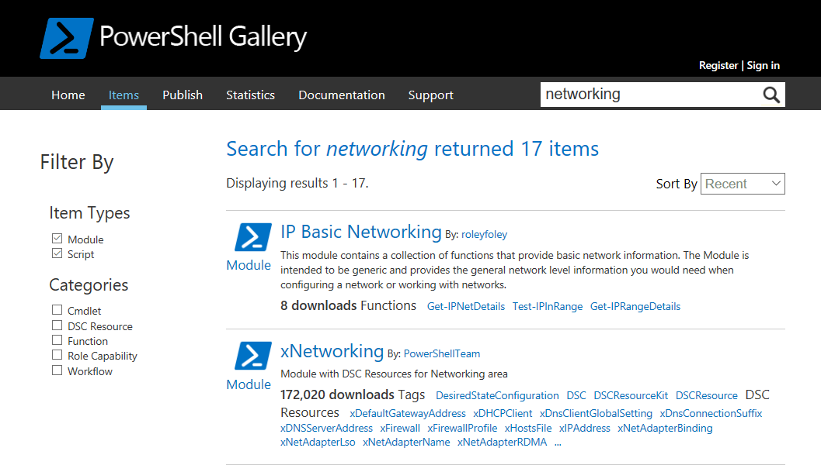

Slide 34

Next steps:
* Search
* Try
* Community

Slide 35
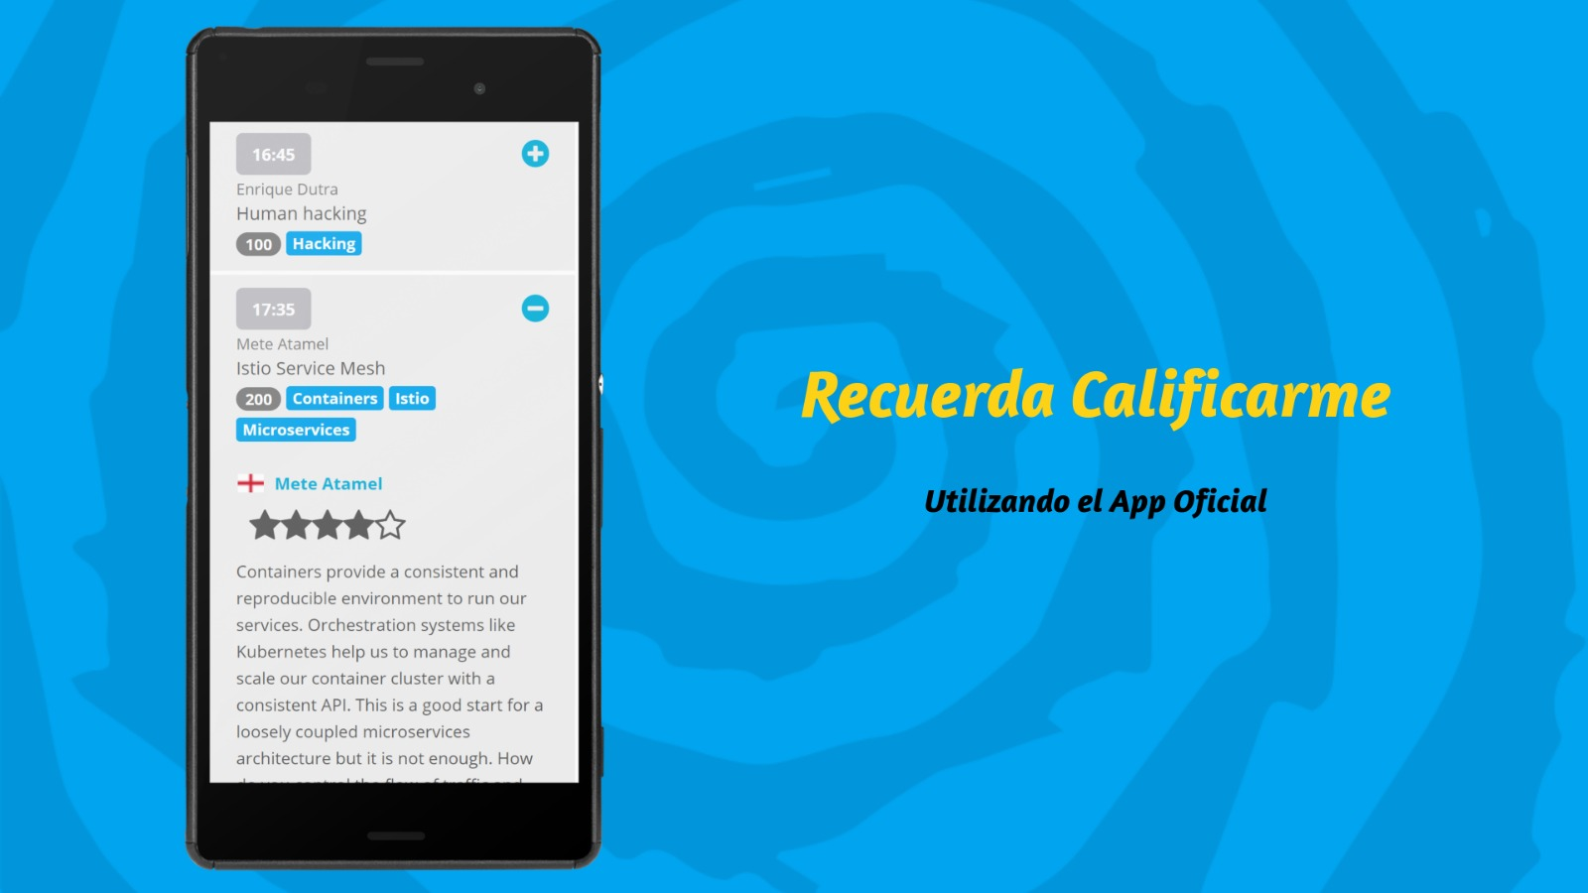
Gracias!
Victor Silva
vmsilvamolina@Gmail.com
@vmsilvamolina
https://log.victorsilva.com.uy

